Slide 1
Online Enrollment
Who are these people? Where did they come from?
What have they done to us?

Slide 2
Who are our online students?
64.8% are female.
81% are white.
89% are residents of Minnesota.
62% are academically disadvantaged.
1/3 of our students take all of their classes online.

Slide 3
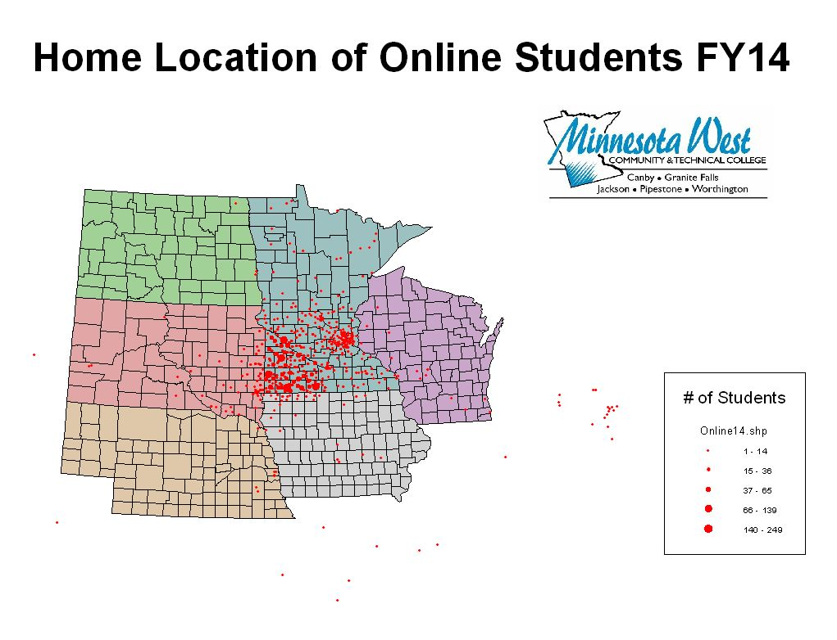
Notes:
Based on headcount

Slide 5
 | 2008 | 2009 | 2010 | 2011 | 2012 | 2013 | 2014
Online Learning | 27% | 31% | 35% | 35% | 43% | 45% | 46%
Other Methods | 73% | 69% | 65% | 65% | 57% | 55% | 54%

Slide 6
How many are there??
In FY 14, 58.6% of our students took at least one online course. That percentage has remained steady for last 3 fiscal years. We show 4842 unduplicated headcount for FY14. That means 2,837 unique students took one or more credit online.
In FY 14, 948 FYE or 46% of our registered credits were online. In comparison, Lake Superior had 28%, Mstate 24%, Riverland 30%, Ridgewater 16%, MSU Mankato 12%, Southwest MSU 12%. Total FYE 2072. Online 948.

Slide 7
Impact on facility Utilization
% Online Credits % Facility Utilization *
Lake Superior 28 71 M State 24 62 MSU – Mankato 12 88 Minnesota West 46 47 Ridgewater 16 61 Riverland 30 50 SMSU 12 67 2 Year Institutions 62 MnSCU System 64
* Spring 2014
Notes:
We’ve all heard the hype about facility utilization. Online learning as both positives and negatives….while online courses do drive FTE, they can hinder an institution’s facility utilization. The key is finding the right mix. Fall utilization usually better than spring. MW Fall 2013 49% MW Fall 2011 66%

Slide 8
How do visiting students find our courses and get registered?
A visiting student is admitted as a degree-seeking student at another institution but is not seeking a degree from Minnesota West.
Students from other MnSCU schools can do a search across the system within their home school eservices, find our course, and register online.
Visiting students can also find online courses on our website OR at www.mnonline.org.
If a student does not have a starID, they can create their own account and register. See http://www.mnwest.edu/index.php/admissions/non-degree-seeking

Slide 9
How many visiting online students do we serve?
Summer of 2012 – 168 students added 38.8 FTE
Fall of 2012 – 203 students added 52.2 FTE
Spring of 2013 – 236 students added 58 FTE
Summer of 2013 – 148 students added 37.6 FTE
Fall 2013 – 169 students 44.7 FTE
Spring 2014 – 183 students added 48.9 FTE

Slide 10
MEDIa CODES 101
Established in effort to increase student access and success in online courses
Better identifies course delivery methods
Better identifies online course requirements
On campus attendance required
Proctored exams
Adobe Connect online lectures at scheduled times
Completely online
Can be confusing – EVEN for ME! ☺
Notes:
How do we get to point A: in the course schedule so we can proceed to point B: registration? With MEDIA CODES
FY 10 Board of Trustees’ Action Plan
Implementation of revised media codes began FY 12 – MnSCU reporting – GOAL – Tell students specifically what will be required in their courses

Slide 11
What is your role?
Faculty :
Review Media Code definitions
Self-identify proper Media Code for online course – Contact Angie with questions
Update course note to reflect specific requirements of course
Staff:
Assist students with finding online courses on class schedule/MnOnline
Assist students with understanding online course requirements based on course note (i.e. – proctored exams may be the face to face meetings for a course)
Notes:
Nobody knows your course better than you. During schedule planning process and as courses change – update media codes and course notes so courses reflect properly on course schedule/MnOnline
Staff – You are who students come to with questions. Jodi’s example.

Slide 12
What doES THE MEDIA CODE mean?
Media Code 03 – “Predominantly Online” Nearly all instruction is delivered online. No more than two required activities or meetings of the class as a cohort may occur face to face in the same physical location. The course may have required proctored exams, in addition to the one or two face to face meetings. A proctored exam is considered one of the face to face meetings if the proctored exam is given to the entire class at a specified time and location. If the student has a choice in when and where to get the exam proctored, the proctored exam is not considered to be one of the face to face meetings.
Notes:
Most confusing. In this example: Appears could be a media 13 because scheduled Adobe Connect lectures; however, students don’t have to attend (view later). Then why not Media 12? Because the class has proctored exams. Can get quite confusing and hard to distinguish.

Slide 13
What doES THE MEDIA CODE mean?
Media Code 09 – “ Blended Hybrid” A course with reduced classroom seat time and some instruction delivered online. The course blends online and face to face delivery. Some of the course content is delivered online. The course has more than two face to face class sessions during the term. Does not display on MnOnline course schedule.
Notes:
Courses with Media Code 09 DO NOT appear on Minnesota Online. They do on MW’s schedule.

Slide 14
What doES THE MEDIA CODE mean?
Media Code 12 – “Completely Online - Asynchronous” All instruction for the course is delivered entirely online. The course has NO required face to face meetings, NO required proctored exams, and NO required “synchronous” meetings (i.e., there are no meetings of the class at a predetermined or scheduled time. A student may still have arranged meetings with small groups of the class or arranged meetings with the instructor.)
Notes:
Most of Minnesota West’s online courses are this media code

Slide 15
What doES THE MEDIA CODE mean?
Media Code 13 – “Completely Online with Synchronous Components” All instruction for the course is delivered online. The course has NO required face to face meetings and NO required proctored exams. The course does have required synchronous online meetings or activities: the full class meets online at a specified or scheduled time.
Notes:
Students have to be online at a certain time for class.

Slide 16
Minnesota Online - How Do Courses get there?
Only courses with Media Codes 03, 12, and 13 display on MnOnline.
Notes:
Explain how will look – Glitches/Issues with search function – Keyword searches and 150 displayed results only

Slide 17
2013-2014 Digital Community Colleges Survey Top Ten-Ranking Winners
Mid-Sized Colleges Category - 4th place
Community colleges are being recognized for their innovative uses of technology to achieve first-rate student learning environments.
Survey questions and criteria examined and scored areas of digital and emerging technologies, such as use of mobile devices and technology integration into curriculum; strategic planning and data management; and professional development, including availability of technology tools and training for faculty and students.
Colleges were surveyed on their technology priorities, infrastructure and networks, collaboration and outreach efforts and use of technology innovations.

Slide 18
Tv – Online

Slide 20
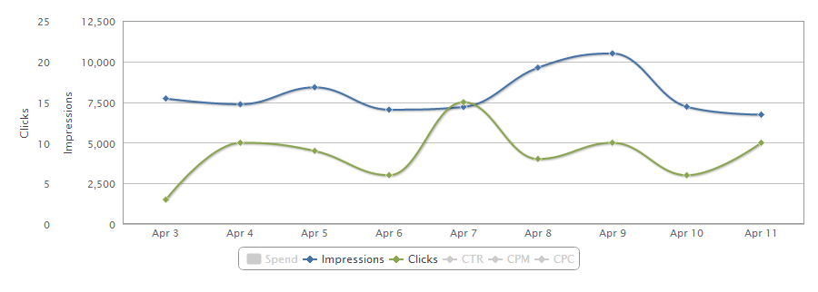
Online Ad Retargeting
Campaign Type | Impressions | Clicks | CTR
Search & Keyword | 34,993 | 46 | .1315 %
Site | 4275 | 12 | .2807 %
Category Contextual | 32,539 | 19 | .0584 %
TOTAL | 71,807 | 77 | .1072%
national average is .07% CTR

Slide 21
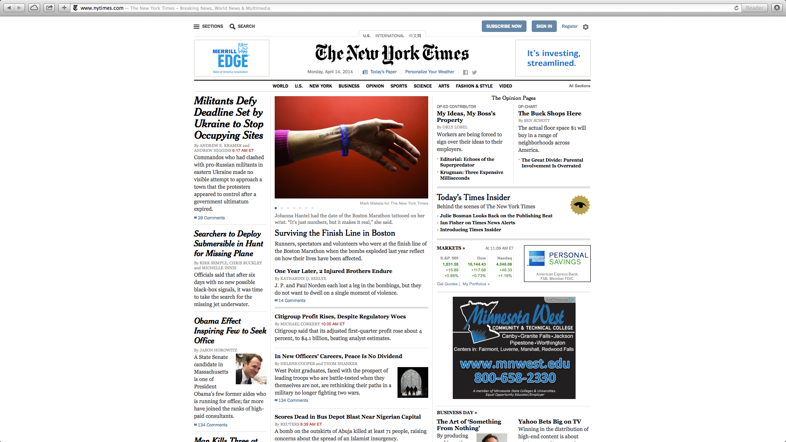

Slide 22
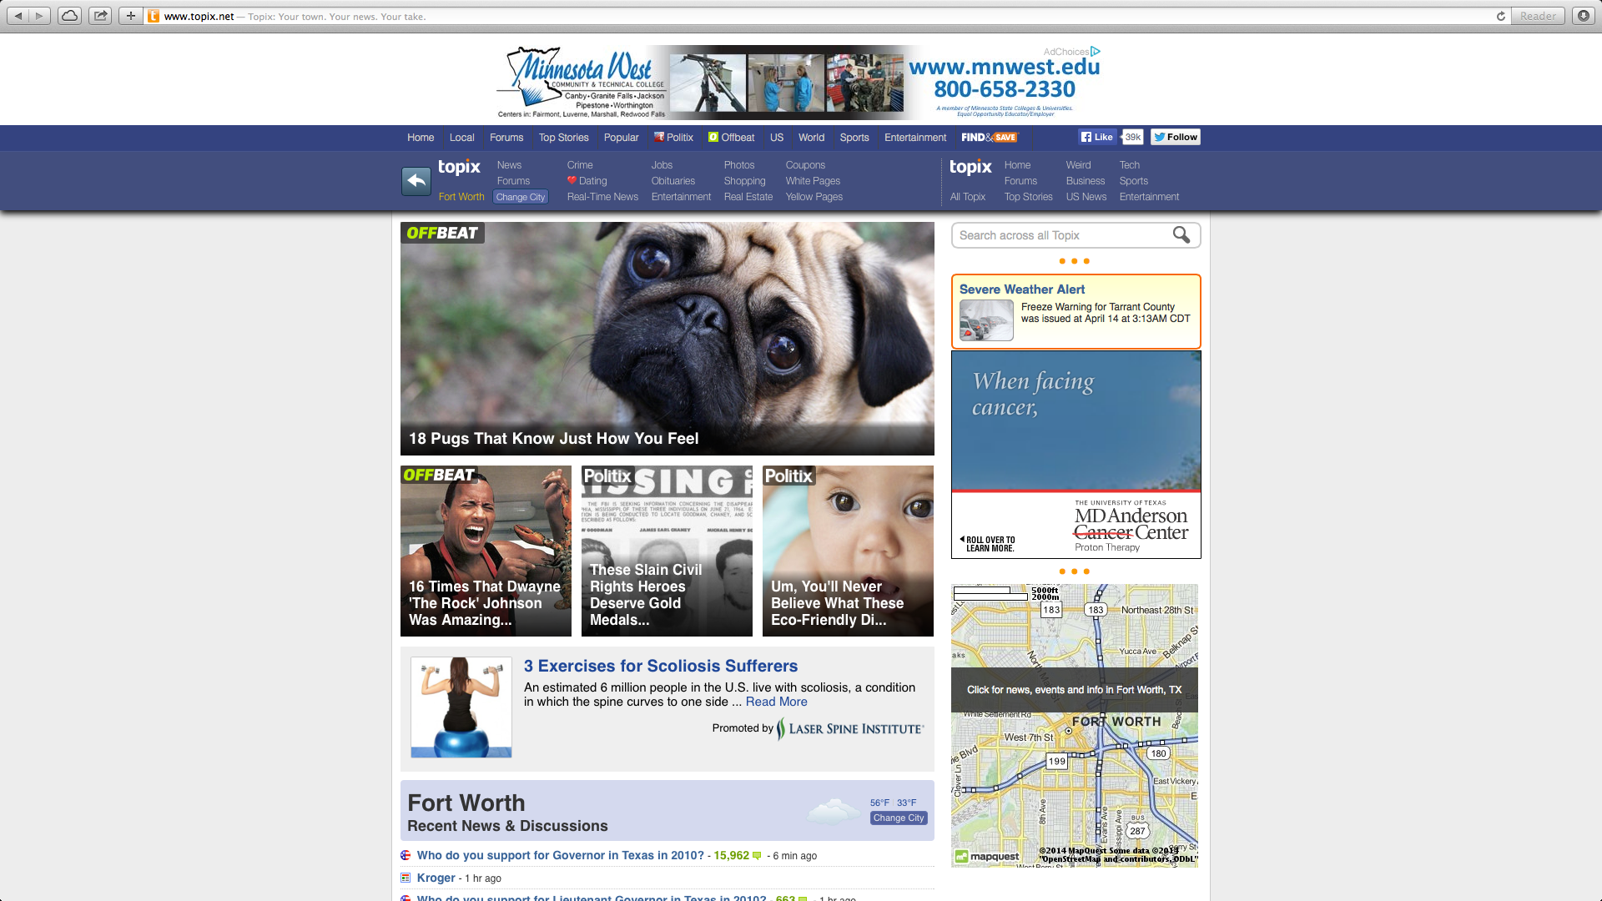
Notes:
From these re-targeting campaigns we can see where our click-thrus are coming from. Which sites, what interests, and demographics that allow us to target much better.

Slide 23
Facebook Advertising

Slide 24
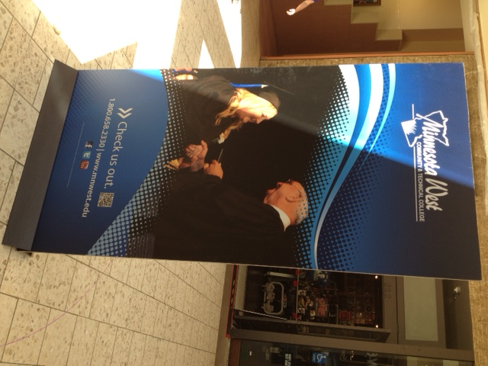
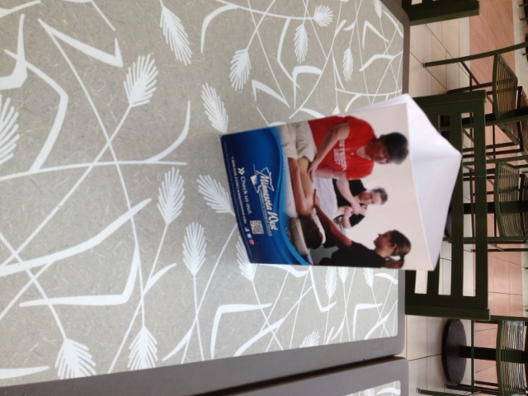
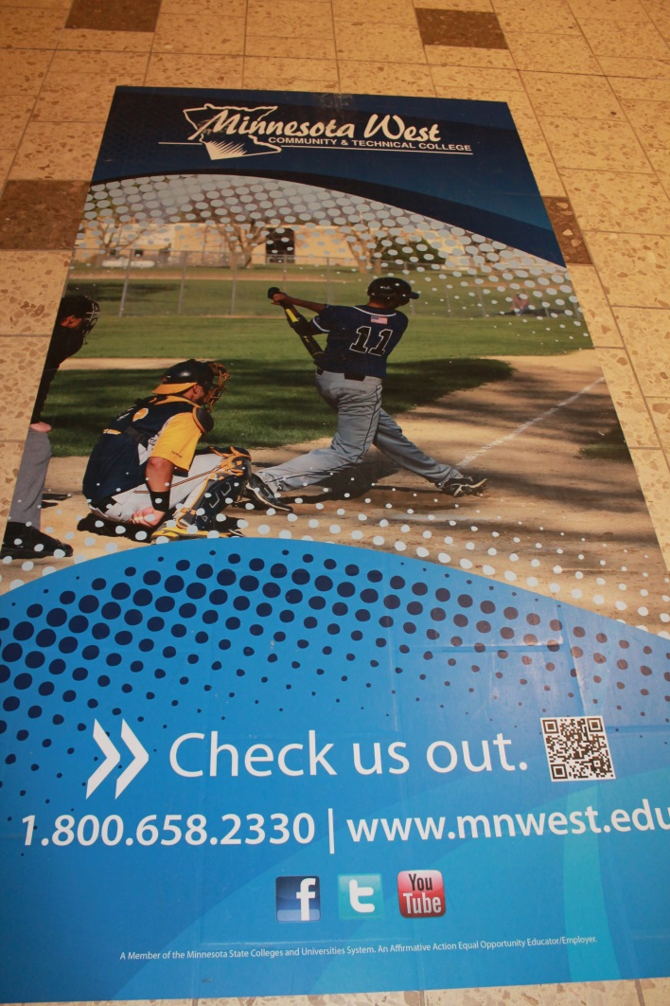

Slide 25
