Slide 1
Biology 1110 Principles of Biology
Biology 1110 Laboratory
Laboratory # 4 Beginning Histology
Muscle, Nervous, & Connective Tissue
Support/Review Materials
All of the micrographs in this presentation were photographed in the MnWest Biology laboratory unless otherwise noted.
The microscope symbol that you see indicates a change in microscope power. A left mouse click on the microscope most often increases the viewing magnification. Give it a try.

Slide 2
There are three categories of muscular tissue
1. Skeletal or striated muscle. This is your most abundant muscle and is responsible for moving the skeleton. This is consciously controlled and therefore it is also called voluntary muscle.
2. Smooth or involuntary muscle. This muscle cannot be willfully controlled. It is said to be the musculature of the hollow organs. Numerous specific locations will be mentioned.
3. Cardiac or heart muscle.

Slide 3
General Muscle Slide
Regardless of the type, the most highly developed and distinguishable feature of a muscle cell is its contractility.
Muscle fibers (cells) have the ability to contract (shorten), and in doing so develop the force that is necessary for movement.

Slide 4
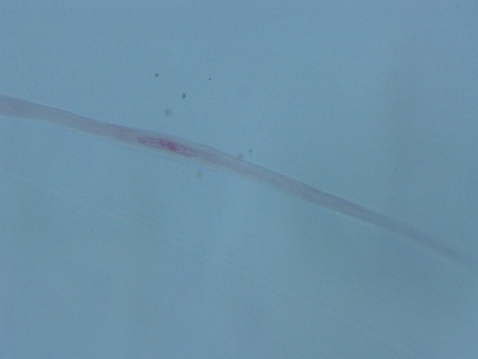
Smooth Muscle
Smooth muscle is also called involuntary muscle. We cannot regulate its contraction consciously.
This is the muscle of our “hollow” organs.
The musculature of most of the digestive tract is smooth.
The two micrographs above demonstrate two smooth muscle fibers (cells). They are small, tapering cells with a single, centrally located nucleus.

Slide 5
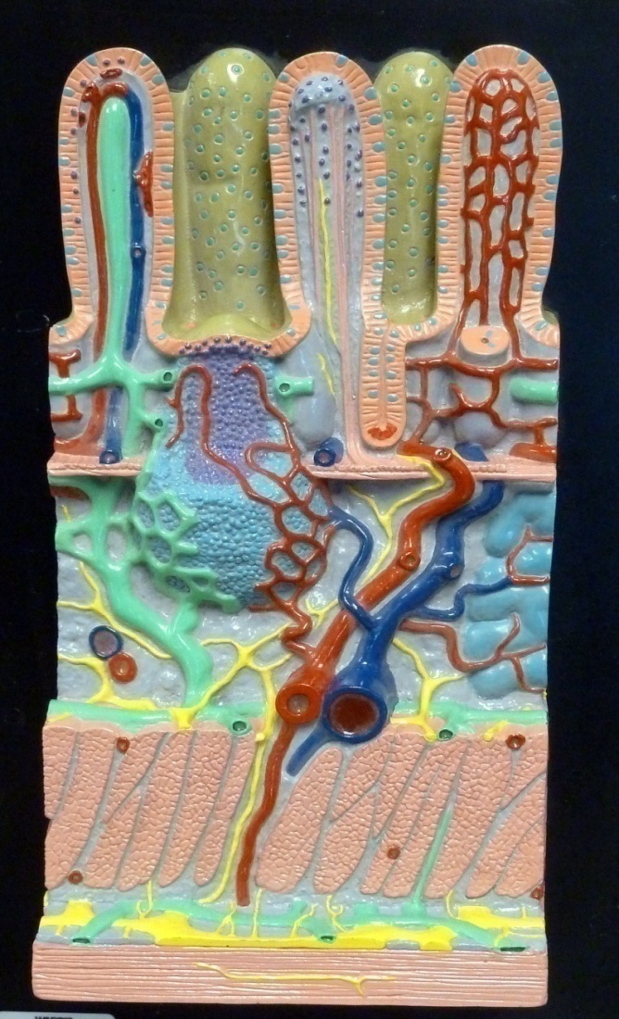
Smooth Muscle
Most of the musculature of the digestive tract is smooth muscle. This would include most of the esophagus, the stomach, and the small and large intestine.
The two layers of smooth muscle demonstrated in small intestine model are pointed out.

Slide 6
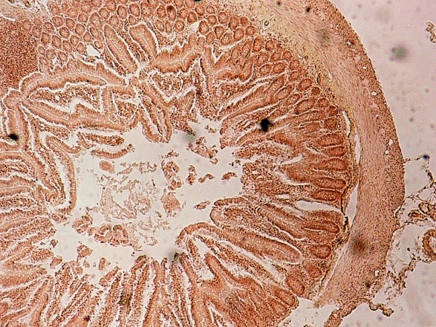
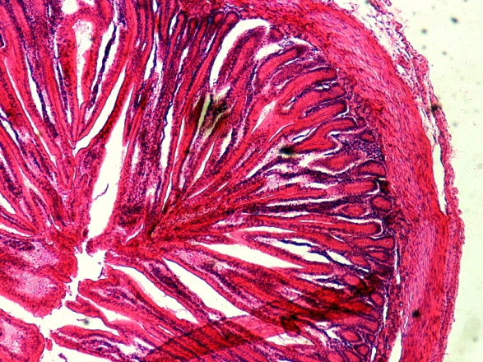
Smooth muscle
A cross-section of the intestine of a mouse on low power
A cross-section of small intestine from a guinea pig.
Let’s take a look on high power

Slide 7
Smooth Muscle
Two layers of smooth muscle are clearly visible
In addition to the digestive tract, smooth muscle is found in the wall of much of the reproductive tract, the wall of the urinary bladder, and the wall of your arteries and veins.

Slide 8
Skeletal Muscle
When you first think of muscle you probably think about your skeletal muscle.
You have well over 600 named skeletal muscles in your body.
Skeletal muscles attach to your skeleton, and when they contract produce a body movement.
The torso model demonstrates a number of the more superficial, and better known muscles.

Slide 9
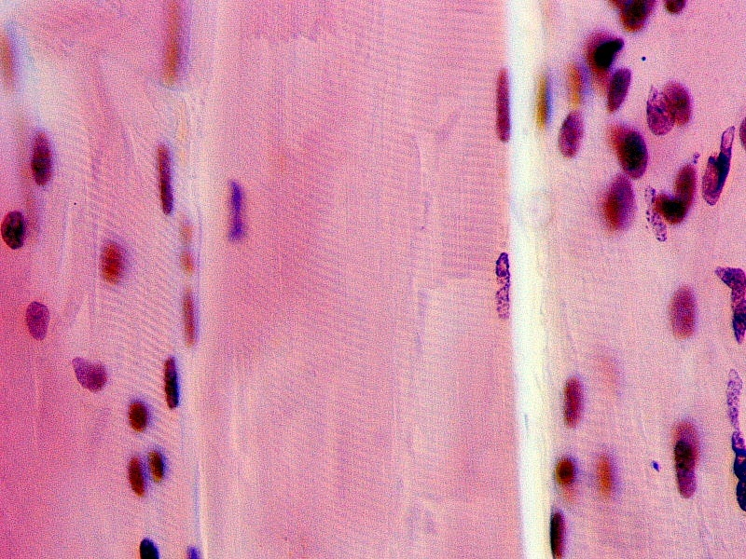
Skeletal muscle micrographs
The top micrograph demonstrates the longitudinal view of skeletal muscle.
The high power micrograph clearly demonstrates two distinguishing features. Note the banded (striated) appearance, and the many stained nuclei.

Slide 10
Skeletal muscle micrographs
Multinucleation
(many nuclei per cell)
Skeletal muscle cells are as long as the muscle they help make up. Each of these long, thin cells has numerous nuclei ( multinucleation).
The banded (striated) appearance is due to the arrangement of the contractile proteins within the cell.
Striations

Slide 11
Cardiac Muscle

Slide 12
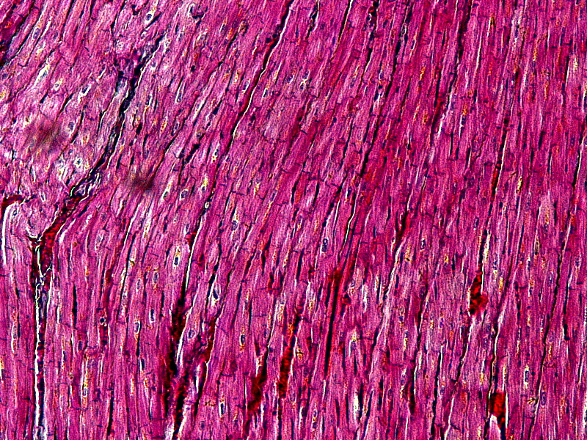
Cardiac Muscle
,,,
Cardiac or heart muscle is the most abundant tissue in the heart. It is responsible for the pumping action of the heart.
We can identify the branching, fiber-like cells, and the presence of intercalated disks in this low power micrograph.
Let’s take a look on high power.

Slide 13
Cardiac Muscle
On high power we can see numerous branch points and the intercalated disks.
Intercalated disks contain fast communicating junctions called gap junctions.
Intercalated disks allow for rapid electrical communication and coordination from heart cell to heart cell.
Intercalated disks

Slide 14
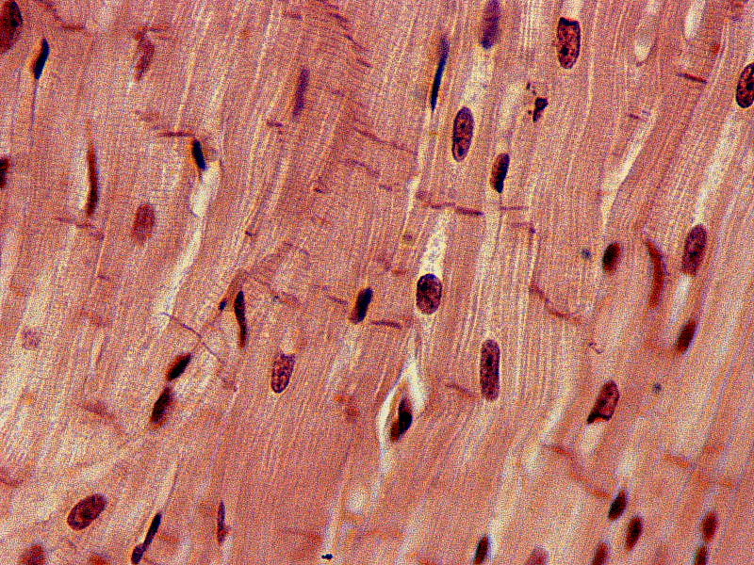
Cardiac muscle
Can you recognize this tissue as cardiac muscle?
Look for branching muscle fibers and intercalated disks.
Remember that the branching nature and intercalated disks allow for the rapid communication necessary for rapid and coordinated heart activity.

Slide 15
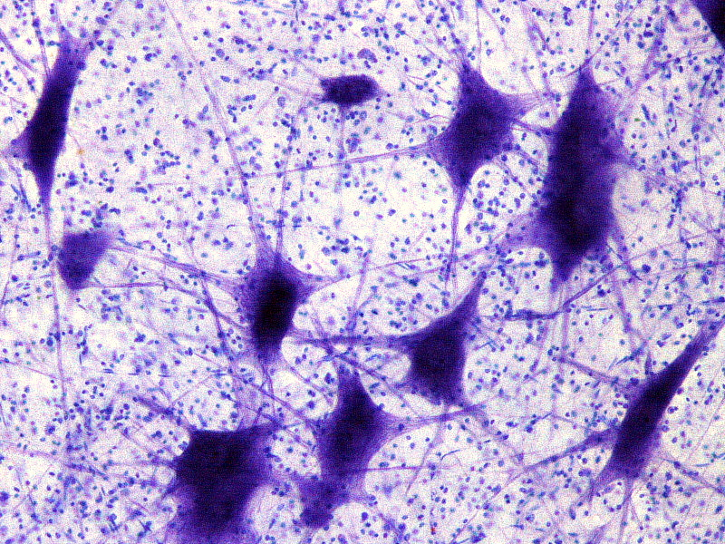
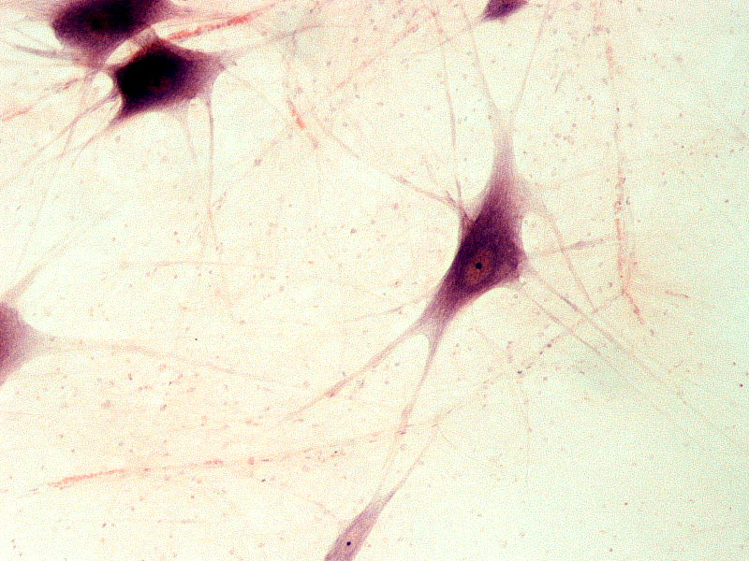
Neurons
.
There many different cell types found within the nervous system.
The cells in the low power micrographs on the right are neurons.
Note their unusual shape, and numerous extensions or processes.
Lets take a closer look.

Slide 16
Neurons
Neurons are the basic information processing cells of the nervous system.
Neurons receive information, process information and send information out.
The cell processes evident in the micrograph are the cell’s axon and dendrites.

Slide 17
Compare the diagram of the neuron with the micrograph.
Identify the cell processes (axon and dendrites), the cell body (soma), and the nucleus within the cell body.

Slide 18
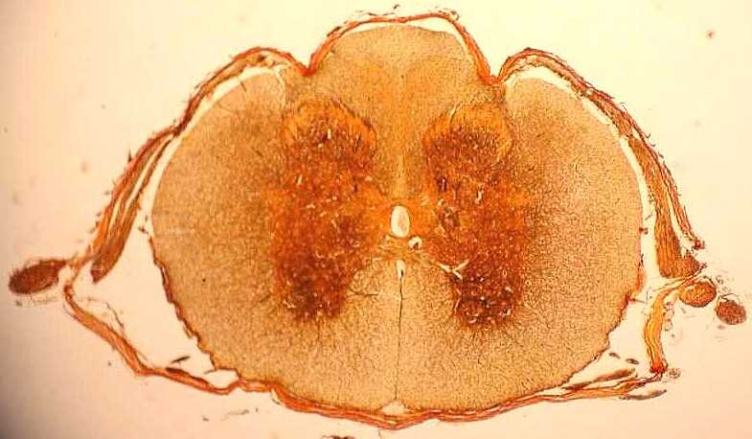
Spinal Cord cross-section
The central, darker region is the gray matter. It has somewhat of a butterfly shape to it.
The gray matter is packed with neurons.
The surrounding, lighter area is called the white matter.
The white matter contains nerve tracts ascending and descending the spinal cord.
Gray matter
White matter

Slide 19
Spinal Cord cross-section
This spinal cord model clearly demonstrates the gray matter and the white matter.
The model also demonstrates the nervous connections entering and leaving the spinal cord.
It is through these connections that the nervous system gathers information and exerts control over many body systems.

Slide 20
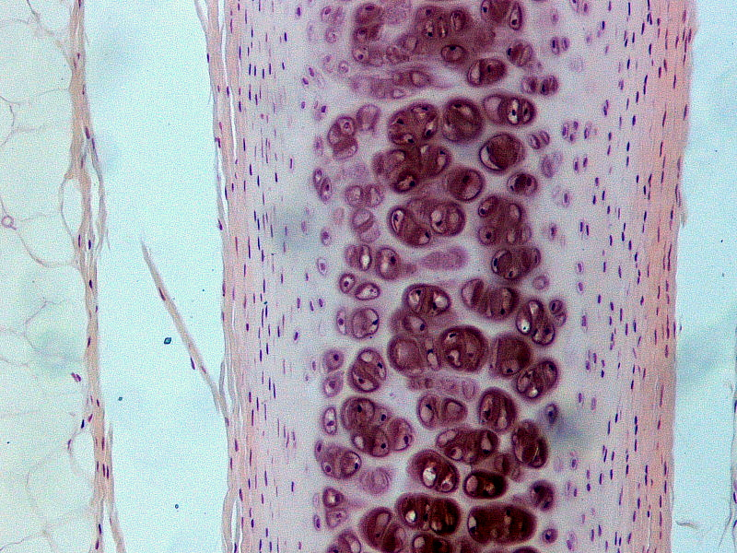
Connective Tissue
There are a variety of connective tissues in the body, including the cartilages, bone, adipose tissue and blood (previously covered).
In this exercise we will look at hyaline cartilage and then bone.
The low power micrograph to the left nicely demonstrates hyaline cartilage.
Lets take a closer look.

Slide 21
Connective Tissue Hyaline Cartilage
Chondrocytes
Note that the chondrocytes (cartilage cells) are not tightly packed together and that there is significant substance between the cells.
The material between the cells is produced from these cells and is referred to as matrix.
The matrix provides the supportive & connective function of the tissue.
matrix

Slide 22
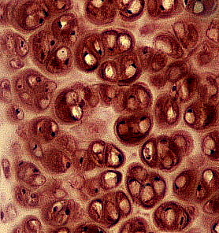
Where do we find Hyaline cartilage?
The fetal skeleton is first made of hyaline cartilage
The attachment of the ribs to the sternum is mostly hyaline cartilage.
The cartilage found within the respiratory system is this type of cartilage.
Hyaline cartilage is found in many articulations (joints) in the body (next page).

Slide 23
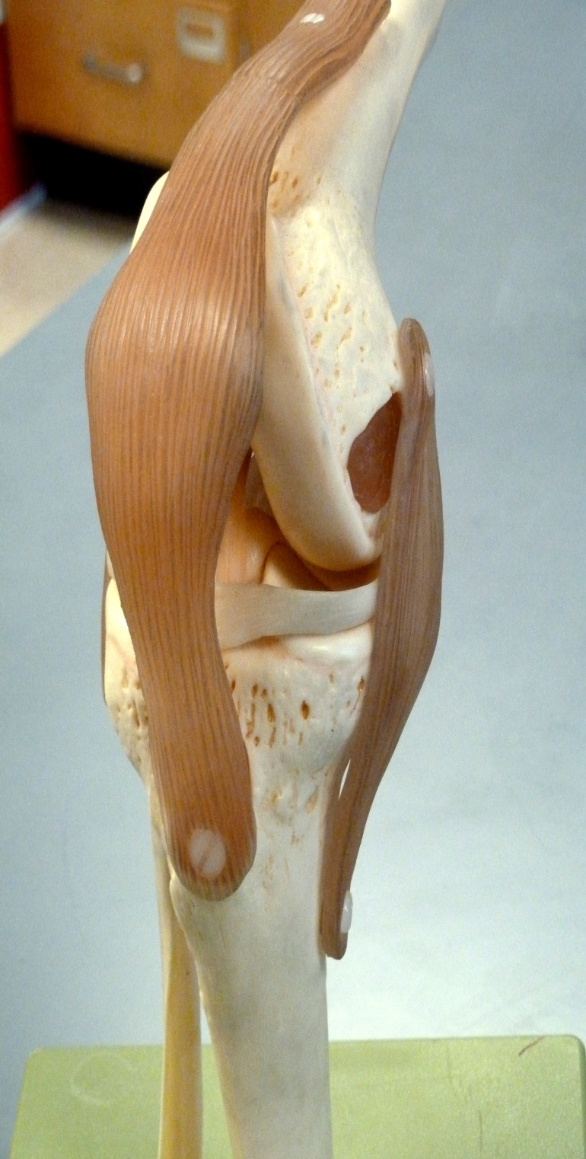
Hyaline Cartilage
This type of cartilage covers the articular surface of bone. The articular surface is the area of the bone involved in an articulation (joint).
This tissue is smooth and moist and helps facilitate movement.
The meniscus of the knee joint is formed by tough fibrocartilage.
A third type of cartilage is elastic cartilage. It is very flexible – grab your ear.
Hyaline cartilage covering articular surface

Slide 24
Connective Tissue Bone
A typical human skeleton contains 206 bones.
Your bones are involved in support, protection, movement, mineral metabolism and blood cell production.
In the next slides, we will look at a long bone macroscopically and microscopically.

Slide 25
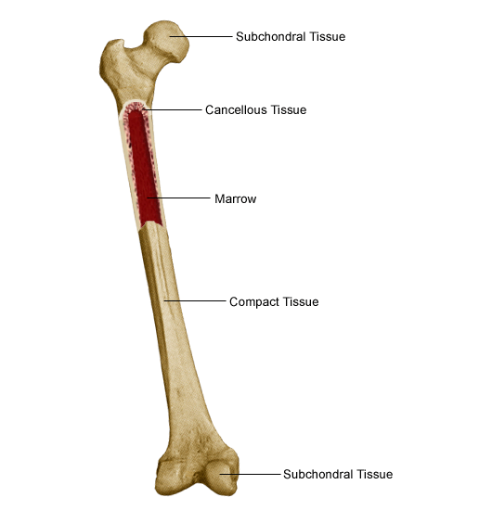
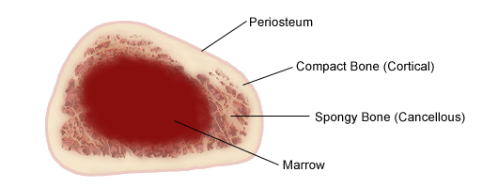
Connective tissue Bone
The long bone presented in the picture and diagram is a human femur.
We can see that the structure is not solid (compact) bone all the way through.
We note the presence of the marrow cavity. Red bone marrow is involved in the production of blood cells.

Slide 26
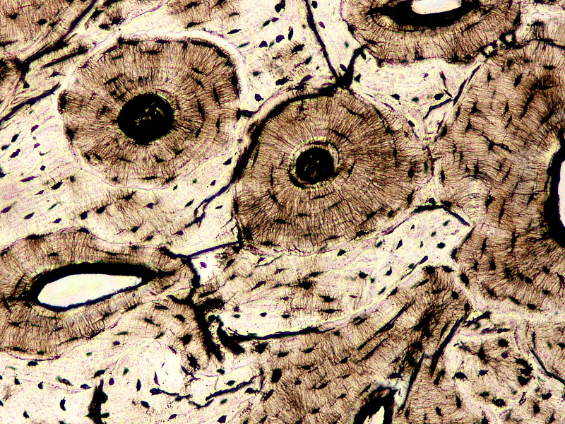
Bone is a living tissue with the bone cells (osteocytes) imbedded in the solid bone.
The living bone cells must be nourished and supported in numerous ways.
Note the haversian canals coursing through the solid bone in this micrograph.
The bone cells are organized around these haversian canals.
Haversian canals

Slide 27
The haversian canal and surrounding bone cells make up what’s called a haversian system
Comparing the bone chip model to a high power micrograph of bone should prove helpful to our understanding of this tissue.
Matrix – the mineral-based substance between bone cells (the hard, compact bone)
Haversian canal
Bone cells (osteocytes)
Canaliculi – little channels of communication

Slide 28
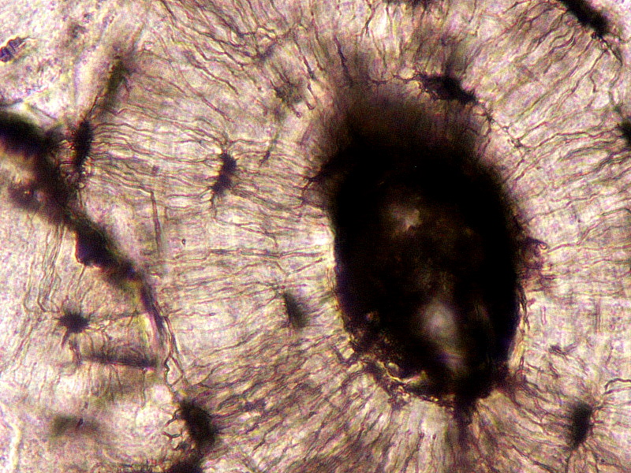
The Haversian System
The haversian canal is a communication pathway that supports the life of the bone cells.
Within the haversian canal we find the blood supply, nervous connection and lymphatics that support the life of this tissue.
Can you identify the components of the haversian system in this high power micrograph?

Slide 29
The End

Slide 30
Try it again

