Slide 1
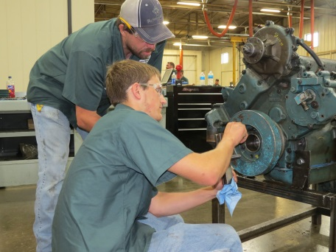
Learn with Purpose.

Slide 2
How to Choose the RIGHT college?
Look for what you want in a college!
Close or far away?
Large or small?
Public or Private?
What do you want to study?
City, small town or the country?
Extracurricular/sport considerations?
Cost of attending?
Affiliations
Open House/Visitation Day?
Personality fit?
Don’t be caught up in a “name”. Where to go is not as important as what you do when you get there.

Slide 3
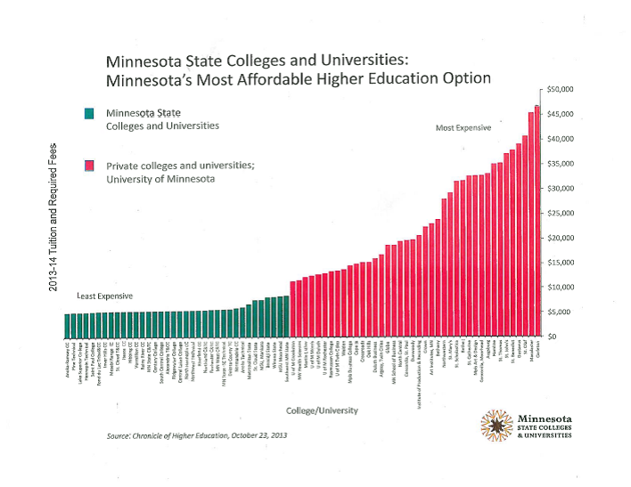
Cost Comparison
Minnesota West

Slide 4
To Finish the Degree or Not?
Staying at Minnesota West to finish your Associate’s degree has great advantages:
It’s saves you money
Once your Associate’s is achieved, it is accepted at all MnSCU system schools – the credits you’ve earned cannot be denied (leaving without it means colleges can turn down your elective credits – private schools can turn down all your credits)
More time on a smaller campus to gain experience/achieve success
Options to also get your degree 100% online

Slide 5
What Should I Study?
Deciding what to major in is one of the hardest choices for students.
What about claiming “undecided” for their choice of major? This can be time-consuming (more years in college) and costly!
Better to be undecided at a small college where the student may receive more personal attention.
Choosing a major depends on a lot of variables:
Abilities
Interests
Values
Career outlook (availability/growth)

Slide 6
What Should I Study?
Students should think about things they like to do, subjects in school that they like, things they enjoy that they are good at or topics which fascinate them.
Shadowing is invaluable! So are internships!
Sometimes students plunge in to a major only to later realize it’s not what they truly want. About 50% of college students change their major once or more during their undergraduate years.
Resources:
Swmncareers.org
Iseek.org
Careeronestop.org
Take interest tests
Job shadow (Greater MN tax credit)
Visit Colleges
Ask Family & Friends (but use caution)
Notes:
The Greater Minnesota Internship Tax Credit Program allows employers to receive tax credits for the wages paid to these students.
The student must:
a. Be enrolled in an participating institution; and
b. Have completed one-half of the credits necessary for the respective degree or certification; and
c. Not employed by an eligible employer to fulfill degree or certificate requirements as part of his or her academic program’s curriculum.
Internship Provider/Employer agrees that the student:
i. Would not have been hired without the tax credit; and
ii. Did not work for the Internship Provider/Employer in a same or similar job prior to the Internship Start Date listed on the agreement; and
iii. Does not replace a current employee; and
iv. Has not previously participated in the program; and
v. Will be employed at a location in greater Minnesota (Counties other than Anoka, Carver, Chisago, Dakota, Hennepin, Isanti, Ramsey, Scott, Sherburne, Washington, and Wright); and
vi. Will be paid at least minimum wage; and
vii. Will work for a minimum of 16 hours per week for at least 12 weeks; and
viii. Will be supervised and evaluated.

Slide 7
Mike Rowe - Needed: A Willingness to Learn a New Skill & a Willingness to Work Your Butt Off
http://profoundlydisconnected.com/needed-a-willingness-to-learn-a-new-skill-a-willingness-to-work-your-butt-off/

Slide 8
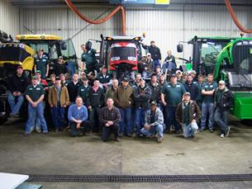
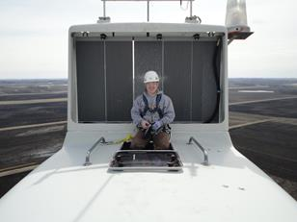
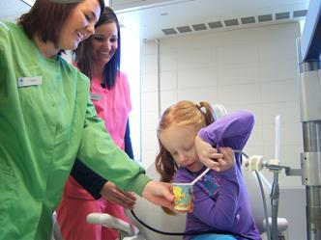
Highlights about our campuses: Canby
Wind – On campus tower for learning
Diesel - (Agriculture) $21.87/hr avg , 5% job growth
Dental Assistant –$21.08/hr avg, 5% job growth
All job look information found at iseek.org based on average Minnesota growth and wage
Notes:
All job outlook information found at iseek.org

Slide 9
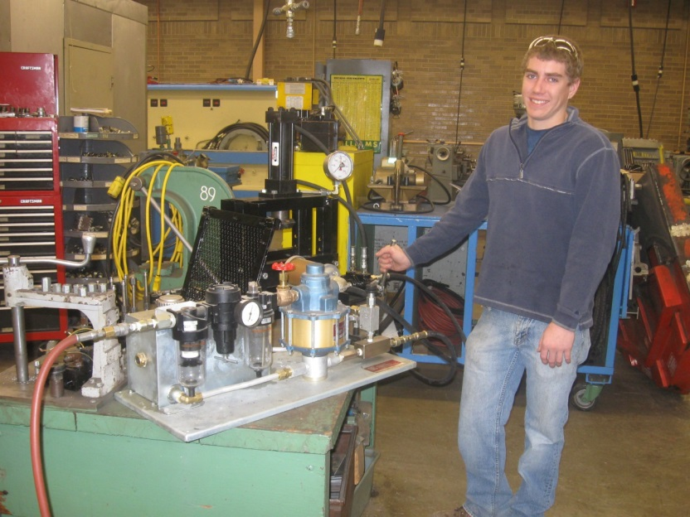
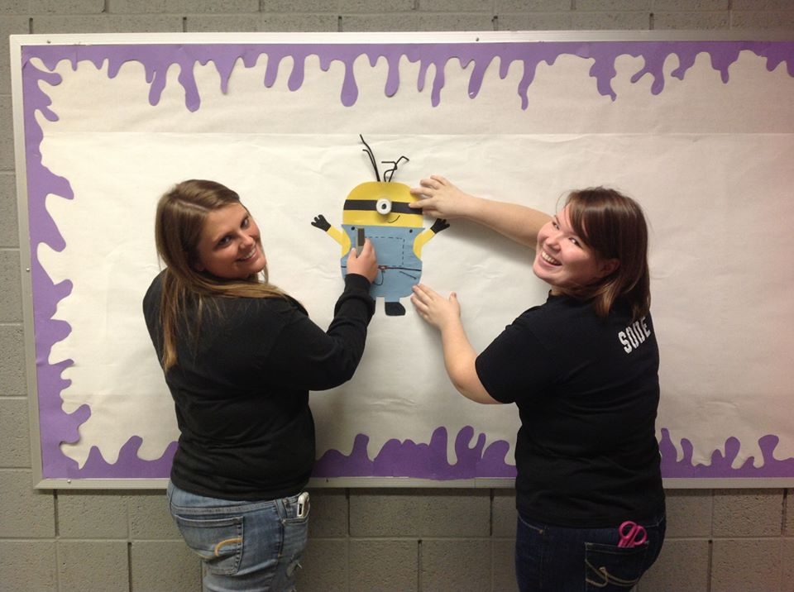
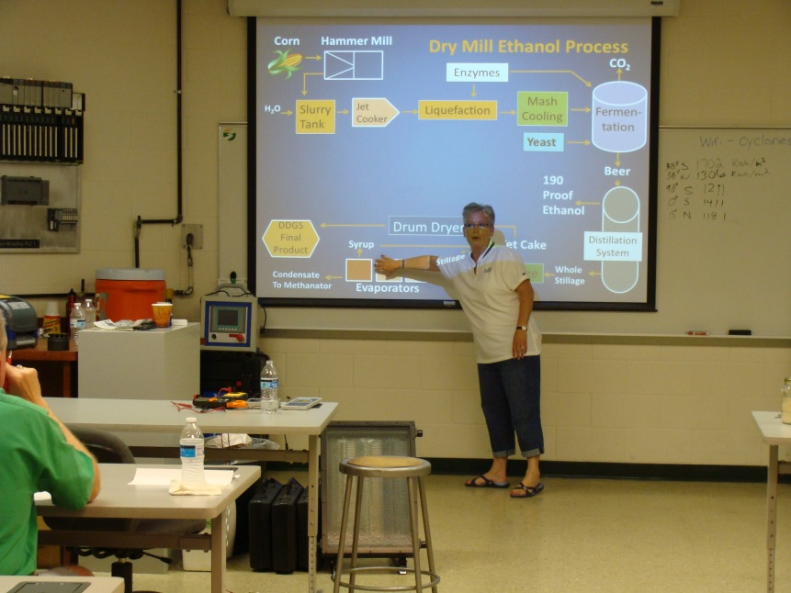
Highlights about our campuses: Granite Falls
Fluid Power Program
100% job placement
Biofuels
Child Development
Various Computer Programs

Slide 10
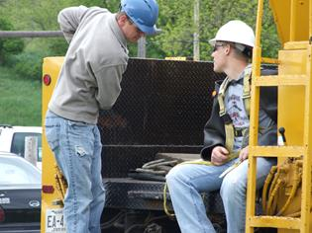
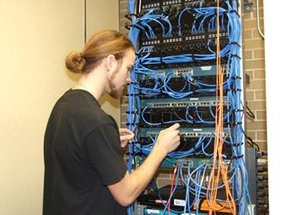
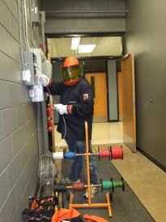
Highlights about our campuses: Jackson
Telecommunications $28.51/hr avg, Growth 3%
Electrician $28.90/hr avg, growth 16%
Powerline, $33.46/hr avg, 7% growth
Welding , $18.21/hr avg, 25% growth
Cosmetology – learn in high end salon atmosphere

Slide 11
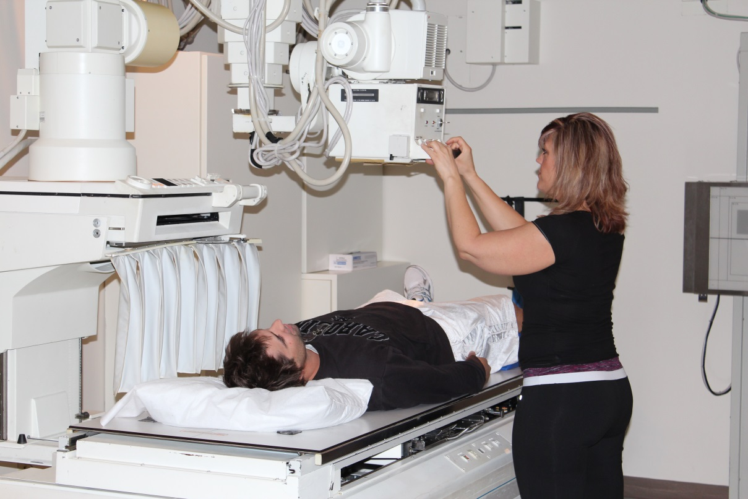
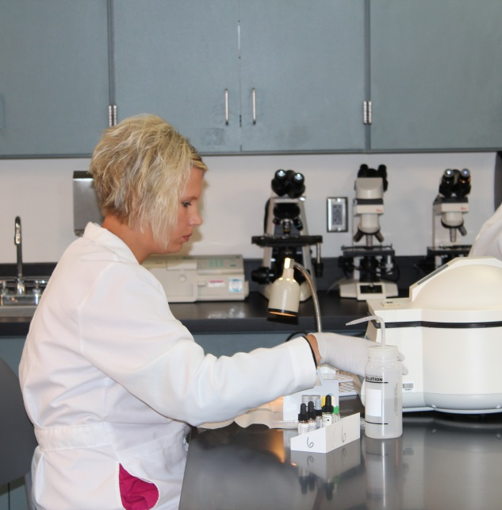
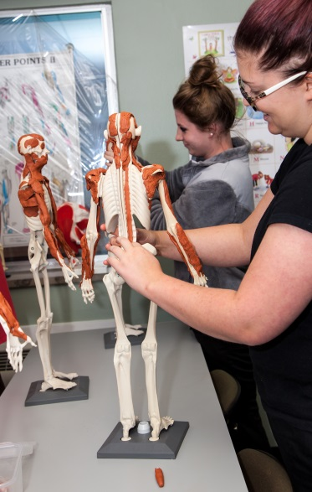
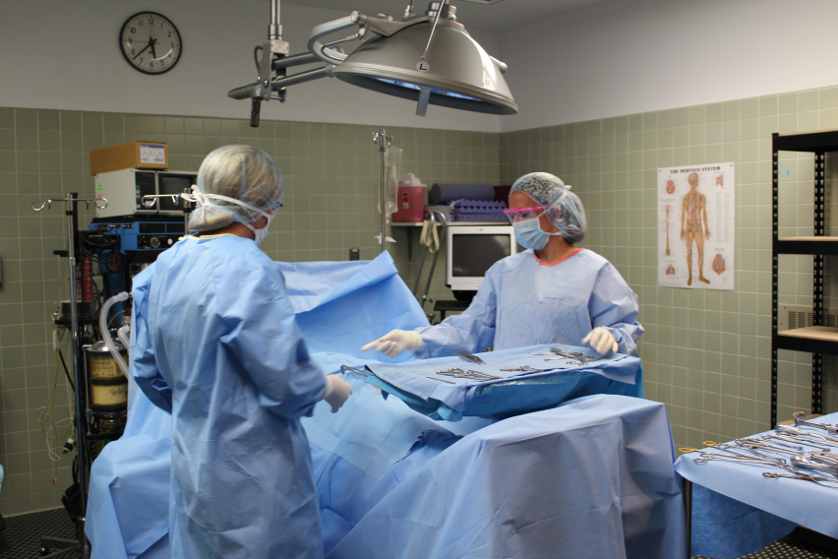
Highlights about our center: Luverne
Leader in allied health programs
Former Luverne hospital – learn hands-on in labs
Radiological Technology, Surgical Technology, Phlebotomy, Medical Lab Tech, Medical Lab Assistant

Slide 12
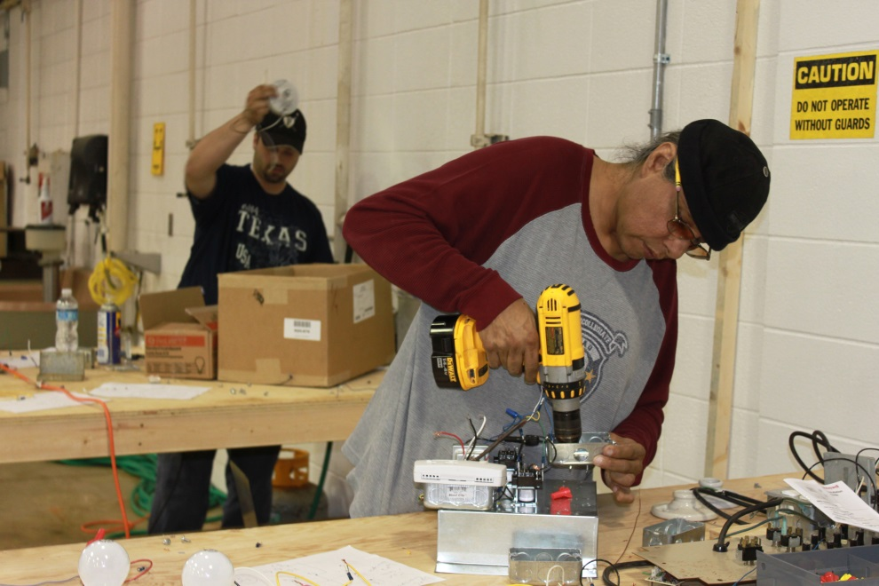
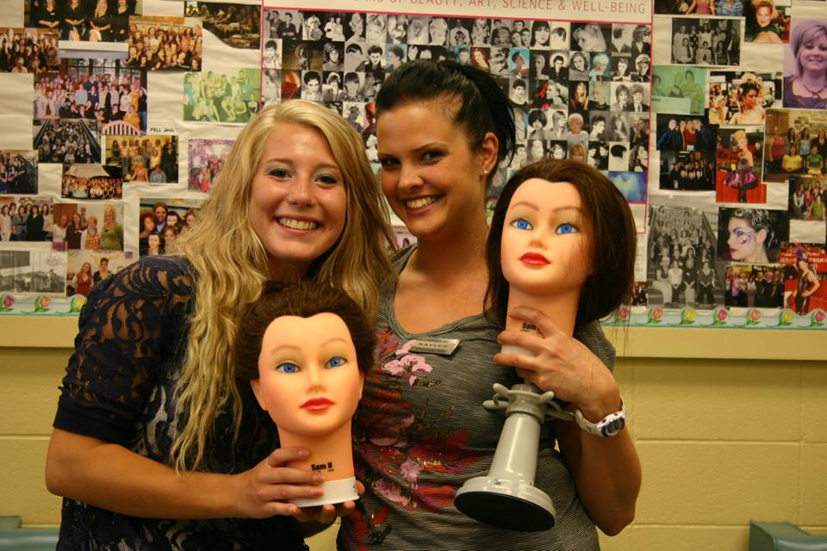
Highlights about our campuses: Pipestone
Nursing – 19% growth
Cosmetology – 5.8% growth
Liberal Arts – Transferrable, online, in-class options
Highlights about our center: Redwood
ITV delivery courses

Slide 13
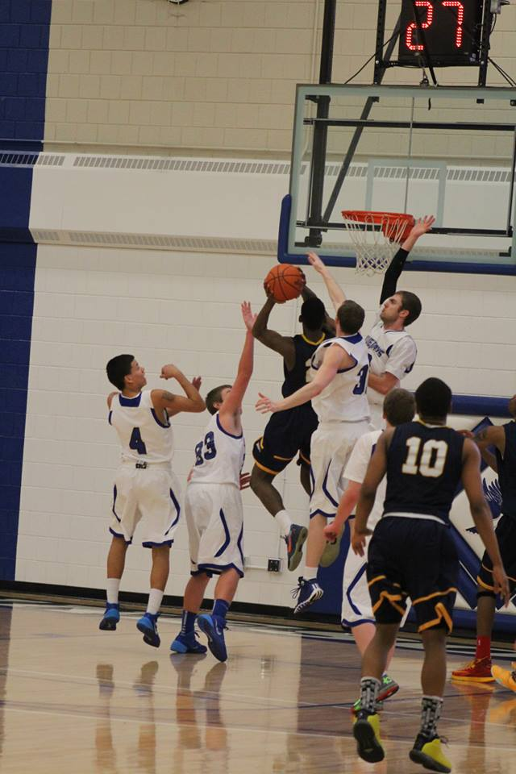
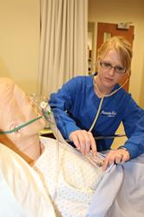
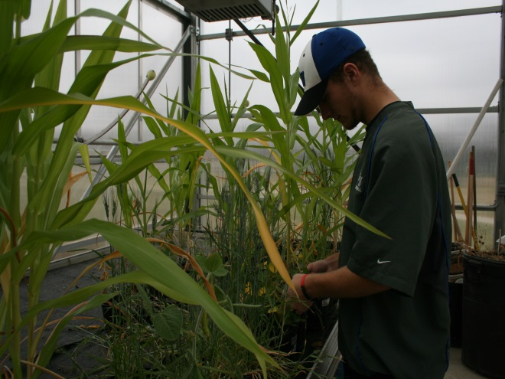
Highlights about our campuses: Worthington
Liberal Arts
Nursing
Agriculture
Industrial Technology
Athletics - $5.5m renovation
Law Enforcement
Computer majors

Slide 14
Financial Aid Opportunities
Grants
Scholarships
Loans
Student Employment – Work Study
www.mnwest.edu/financial-aid

Slide 15
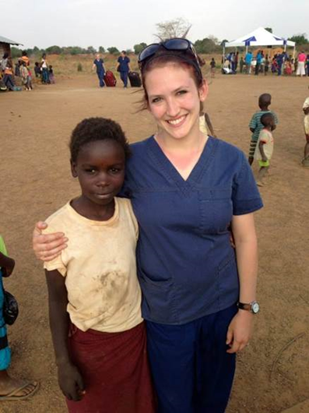
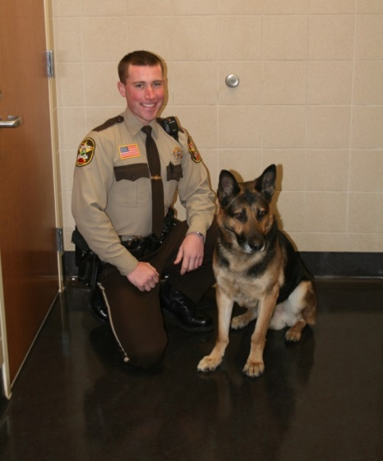
What do our alumni say?
“The skills, and preparation in the education I received, especially cross-culturally, has created my passion and excitement for nursing.”
"Minnesota West was definitely a good start for me, not only because I got to take classes with great people, but I also got to know my professors as a freshman and sophomore. Looking back on it, that was really nice."
“At Minnesota West I gained an associate’s degree and the hands-on knowledge I needed to smoothly transfer to a four-year institution and enter the dietetics career field. Minnesota West helped me figure out who I was and what I wanted to be.”
“I was able to have one-on-one time with my instructors, which in the end assisted in my ability to get a quality education.”
“I would never take back my experience at Minnesota West, the college gave me an incredible experience. When you go to a big university, your ‘generals’ are often held in big seminar rooms with 150-plus students, and you hardly ever get an opportunity to meet one-on-one with your instructor. While at Minnesota West, I was able to complete the majority of my generals in a classroom of 50 students max.”

Slide 16
Contact us
Let us help you to learn more, and to get you the resources and opportunities that fit you!
800-658-2330
info@mnwest.edu
www.mnwest.edu
Many degree ONLINE options as well!

