Slide 1
Department of Defense Institutional Compliance Program
Recruiting, Marketing, and Advertising

Slide 2
Table of Contents
Slide 3: Self-Assessment category 8: Recruiting and Marketing Practices
Slide 4-13: Other issues that have been found by the DoD during the self-assessment process and solutions to those issues.

Slide 3
Self-assessment category 8: Recruiting and Marketing
Relevant MOU Requirement: Sec. 3 (j)
How the Dod wants the institution to prove they follow this requirement:
Have policies in place compliant with program integrity requirements consistent with the regulations issued by ED [Department of Education] (34 C.F.R 668.71-668.75 and 668.14) related to restrictions on misrepresentation, recruitment, and payment of incentive compensation. This applies to the educational institution itself and its agents including third party lead generators, marketing firms, or companies that own or operate the educational institution. As part of efforts to eliminate unfair, deceptive, and abusive marketing aimed at Service members, educational institutions will:
Ban inducements, including any gratuity, favor, discount, entertainment, hospitality, loan, transportation, lodging, meals, or other item having a monetary value of more than a de minimis amount, to any individual or entity, or its agents including third party lead generators or marketing firms other than salaries paid to employees or fees paid to contractors in conformity with all applicable laws for the purpose of securing enrollments of Service members or obtaining access to TA funds. Educational institution sponsored scholarships or grants and tuition reductions available to military students are permissible.
Refrain from providing any commission, bonus, or other incentive payment based directly or indirectly on securing enrollments or federal financial aid (including TA funds) to any persons or entities engaged in any student recruiting, admission activities, or making decisions regarding the award of student financial assistance;
Refrain from high-pressure recruitment tactics such as making multiple unsolicited contacts (3 or more), including contacts by phone, email, or in-person, and engaging in same-day recruitment and registration for the purpose of securing Service member enrollments.
Provide evidence that the institution has taken proactive steps to demonstrate behavior consistent with the regulations issued by ED (34 C.F.R. 668.71-668.75 and 668.14) related to restrictions on misrepresentation, recruitment, and payment of incentive compensation for the institution’s staff and agents in order to end fraudulent and aggressive recruitment of military students. Evidence may include references to employee manuals or handbooks, employee training, defined processes and procedures, or policies. If an attached exhibit is referenced as evidence, please include the exhibit number, document title, and specific page numbers to reference in the response area below. In the self-assessment packet.
The institution is required to ban the practice of providing any commission, bonus, incentive payment, gratuity, favor, discount, entertainment, hospitality, loan, transportation, lodging, meals, or other item having a monetary value to recruiters, other Service members, or any other individuals and entities for the purpose of securing enrollments of Service members or obtaining access to TA funds. The institution certifies that it: meets or does not meet the requirement
The institution does not make multiple unsolicited contacts (3 or more), including contacts by phone, email, or in-person, or engage in same-day recruitment and registration for the purpose of securing Service member enrollments. This certifies that it: meets or does not meet the requirement
Provide evidence that the institution directs Service members to speak with their Educational Services Officer (ESO) or counselor within their Military Service prior to enrolling the student in the institution. Evidence may include references to employee manuals or handbooks, employee training, defined processes and procedures, or policies, student information guides, Help links, URLs, or screen shots. If an attached exhibit is referenced as evidence, please include the exhibit number, document title, and specific page numbers to reference in the response area below. In the self-assessment packet.

Slide 4
Other potential findings and the corrective action plan
The DoD MOU description
What that really means
Corrective Action
4.h.(3), “Educational institutions will provide, where available, electronic access to their main administrative and academic center’s library materials, professional services, relevant periodicals, books, and other academic reference and research resources in print or online format that are appropriate or necessary to support the courses offered. Additionally, educational institutions will ensure adequate print and non-print media resources to support all courses being offered, are available at base or installation library facilities, on-site Institution resource areas, or via electronic transmission.”
The should have electronic access to library materials, books, research material, and other formats that can be beneficial for the student’s class. There should also be enough print and non-print material for each course. Schools also should not have any logos or insignias online.
Remove any pictures that show service members in their uniform or clothing that has insignias or logos. Remove anything on the website that makes it look like the institution is being endorsed by the military.

Slide 5
Other potential findings and the corrective action plan
The DoD MOU description
What that really means
Corrective Action
3.j.(3), institutions are required to, “Refrain from providing any commission, bonus, or other incentive payment based directly or indirectly on securing enrollments or federal financial aid (including Tuition Assistance funds) to any persons or entities engaged in any student recruiting, admission activities, or making decisions regarding the award of student financial assistance.”
Does the institution have a clear policy that states that there is no incentive payment for recruiting service members?
Include the policy on the website.

Slide 6
Other potential findings and the corrective action plan
The DoD MOU description
What that really means
Corrective Action
3.j.(3) institutions are required to, "Refrain from high-pressure recruitment tactics such as making multiple unsolicited contacts (3 or more), including contacts by phone, email, or in-person, and engaging in same-day recruitment and registration for the purpose of securing Service member enrollments.”
Does the institution have a clear policy that prohibits colleges from aggressively contacting service members or not allowing same day recruitment and registration?
Include the policy on the website. Yearly training with pertinent staff.

Slide 7
Other potential findings and the corrective action plan
The DoD MOU description
What that really means
Corrective Action
3.4.g, institutions are required to, “Designate a point of contact or office for academic and financial advising, including access to disability counseling, to assist Service members with completion of studies and with job search activities.”
Does the website have a clear link for service members to find how to contact someone they may need during their time at the institution?
Update contact information on the Veterans’ Services webpage yearly.

Slide 8
Other potential findings and the corrective action plan
The DoD MOU description
What that really means
Corrective Action
4.e.(2), “DoD personnel are entitled to consideration for all forms of financial aid that educational institutions make available to students at their home campus. Educational institution financial aid officers will provide information and application processes for Title IV student aid programs, scholarships, fellowships, grants, loans, etc., to DoD Tuition Assistance (TA) recipients… [And that] Service members identified as eligible DoD TA recipients… will have their TA benefits applied to their educational institution’s account prior to the application of their Pell Grant funds to their account."
Students who are eligible for TA should have their TA applied prior to any other form of financial aid. The website should have information available for students to get help with the financial aid process and the contact information for someone who can help assist them with financial aid.
Make sure the institutions’ website has information readily available for students and that there is contact information for the students.

Slide 9
Other potential findings and the corrective action plan
The DoD MOU description
What that really means
Corrective Action
4.d.(1), “If an eligible Service member decides to use Tuition Assistance (TA), educational institutions will enroll him or her only after the TA is approved by the individual’s Service.”
Does the Veteran have easy access to apply for their benefits if they are eligible?
Have the proper link on the Veteran webpage that will connect the student to the correct page to apply for their benefits. Also, have contact information available.

Slide 10
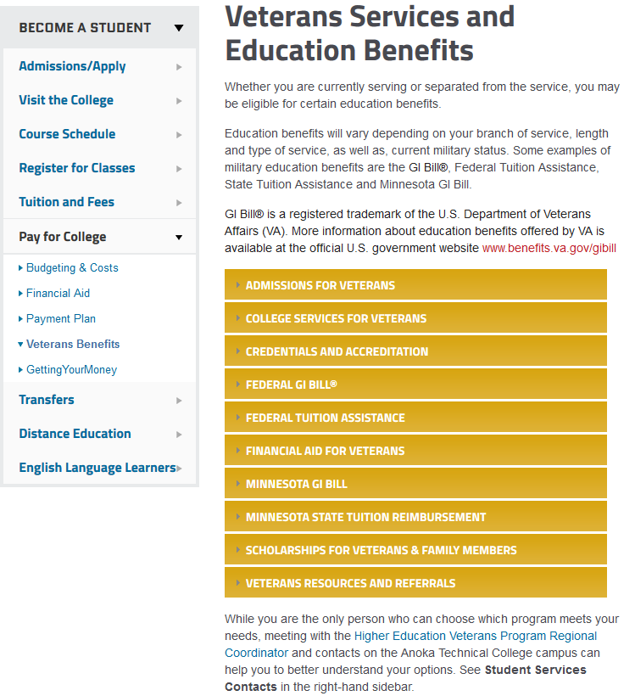
Example from one of our institutions that have completed the self-assessment. Having all the links easily visible on the page is an acceptable webpage

Slide 11
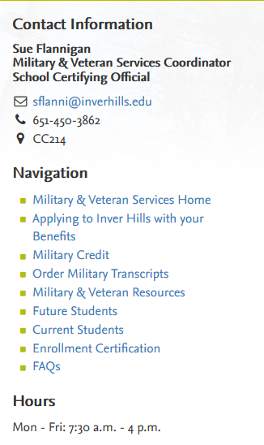
Example from one of our institutions that have completed the self-assessment. Having all the links easily visible on the page is an acceptable webpage

Slide 12
Common area of concern for recruiting
Incomplete guidance on TA processes, including:
Application process
Links to service education portals
Guidance directing students towards ESOs and other military education personnel
Lack of institutional policies promoting behaviors consistent with ED regulations on misrepresentation
Potential Ramification:
Service members could receive inaccurate, incomplete, and/or confusing information to use in their educational decision making

Slide 13
Common non-compliance and what is the best practice
Common non-compliance websites have a hyperlink to an informational website for military tuition assistance but it is not an official DoD or service site.
The best practice is to have hyperlinks to official Service websites.

Slide 14
Common area of concern for marketing and advertising
DoD and/or Military Service insignias and/or logos being displayed on institution websites, providing an implied endorsement by the DoD that could be misleading
Potential ramification:
Service members could inaccurately construe advertising materials as an endorsement from the DoD/Service

Slide 15
Common non-compliance and what is the best practices
Common non-compliance is having pictures or videos of students in military clothing or clothing with military logos
The best practice is to have students in clothing that has no military logo or be in military uniform
Examples of non-acceptable visuals:
Logos/Seals
Insignia
Uniforms
Equipment/material
Command Crests
Patches
Medals

